Slide 1
Hardware Design

Slide 2

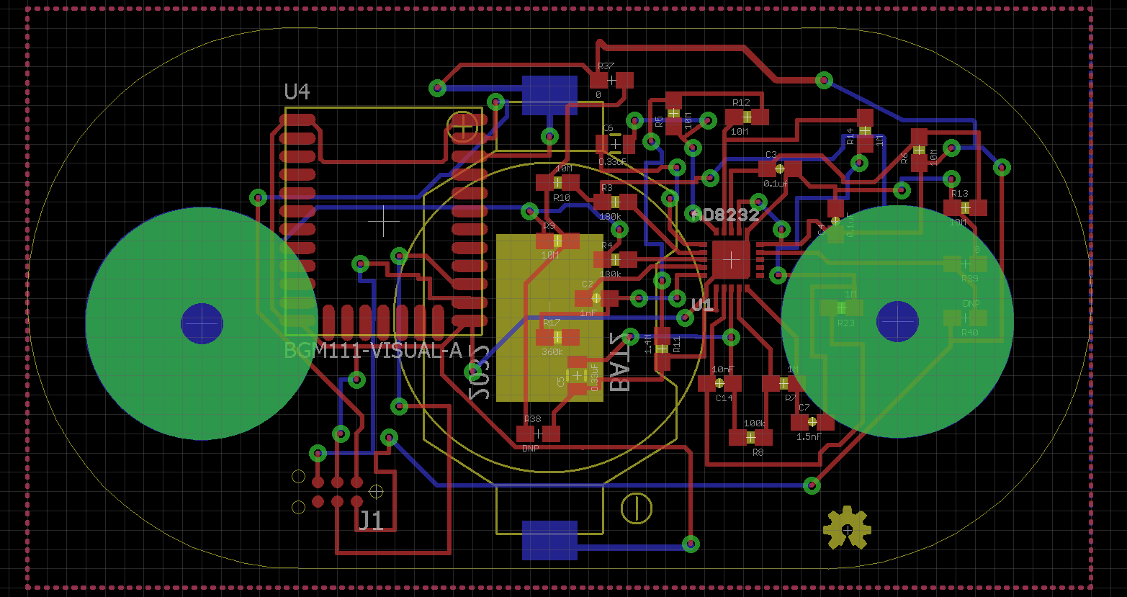
ECG BOARD

Slide 3
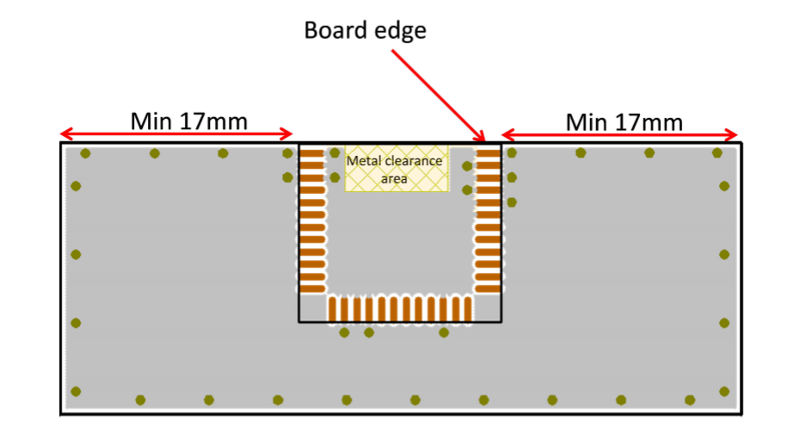
BGM111 : Metal Clearance
BGM111 Module

Slide 4
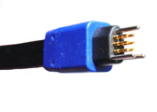
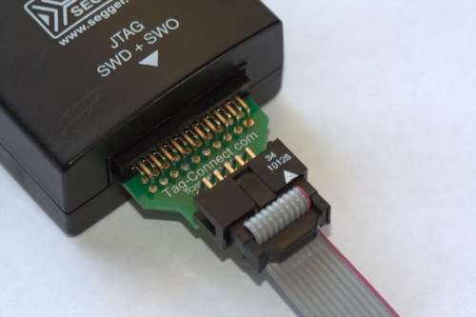
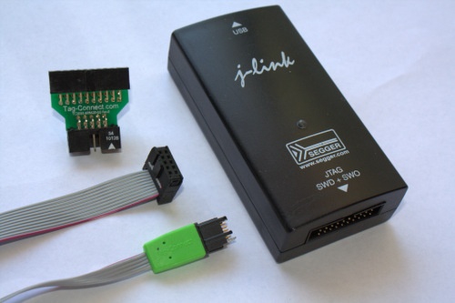
TAG CONNECT FOR DEBUGGING
TAG CONNECT

Slide 5
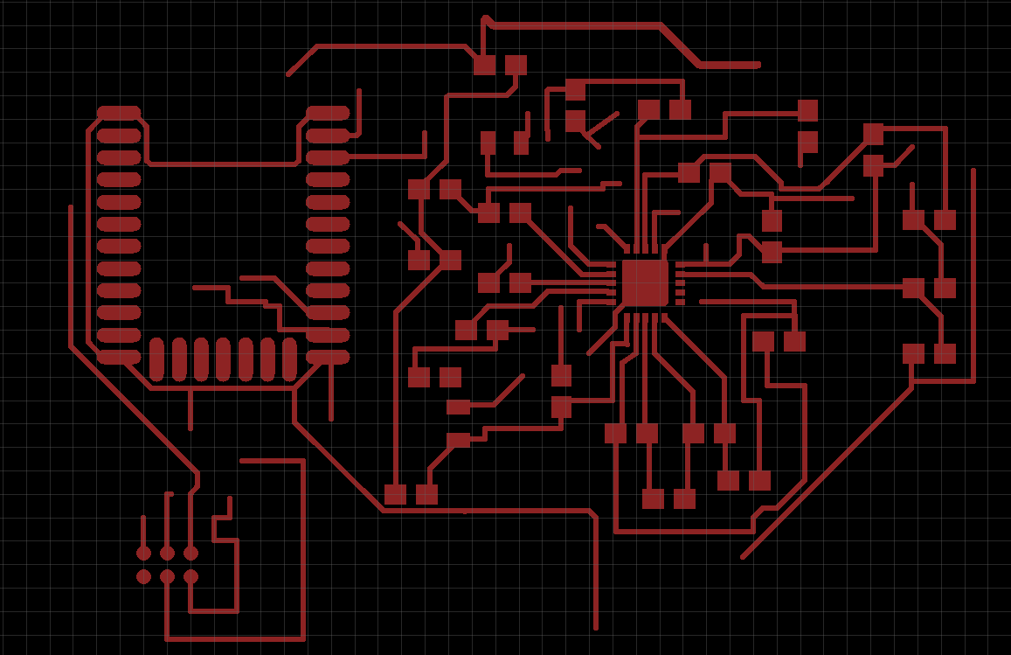
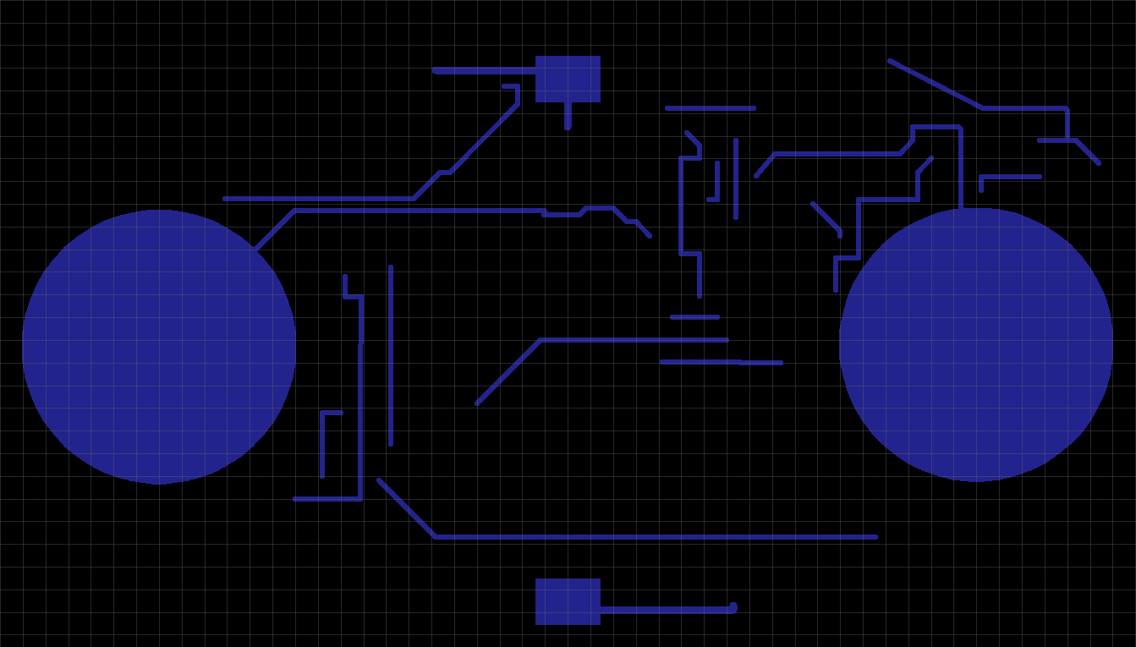
ECG BOARD LAYERS

Slide 6
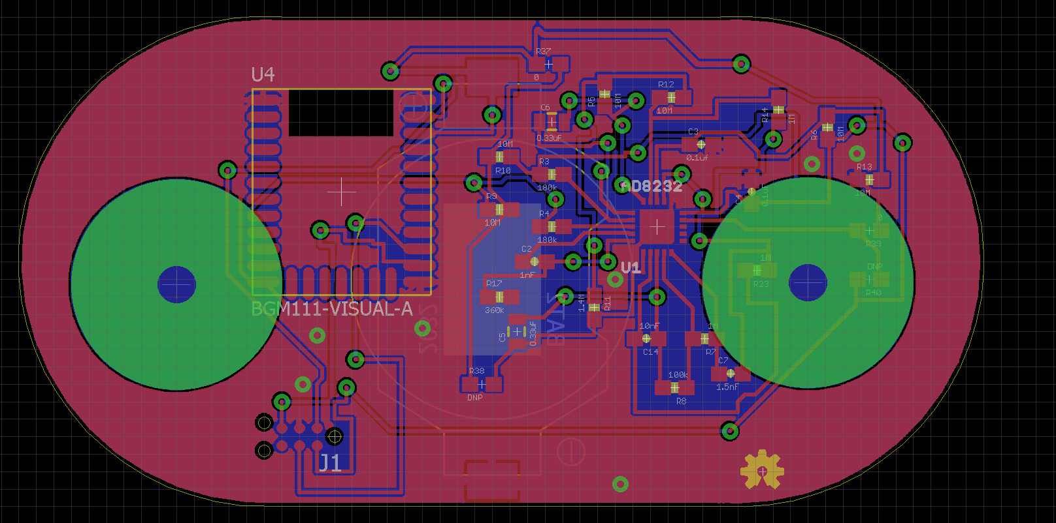
ECG BOARD WITH GROUND PLANES

Slide 7
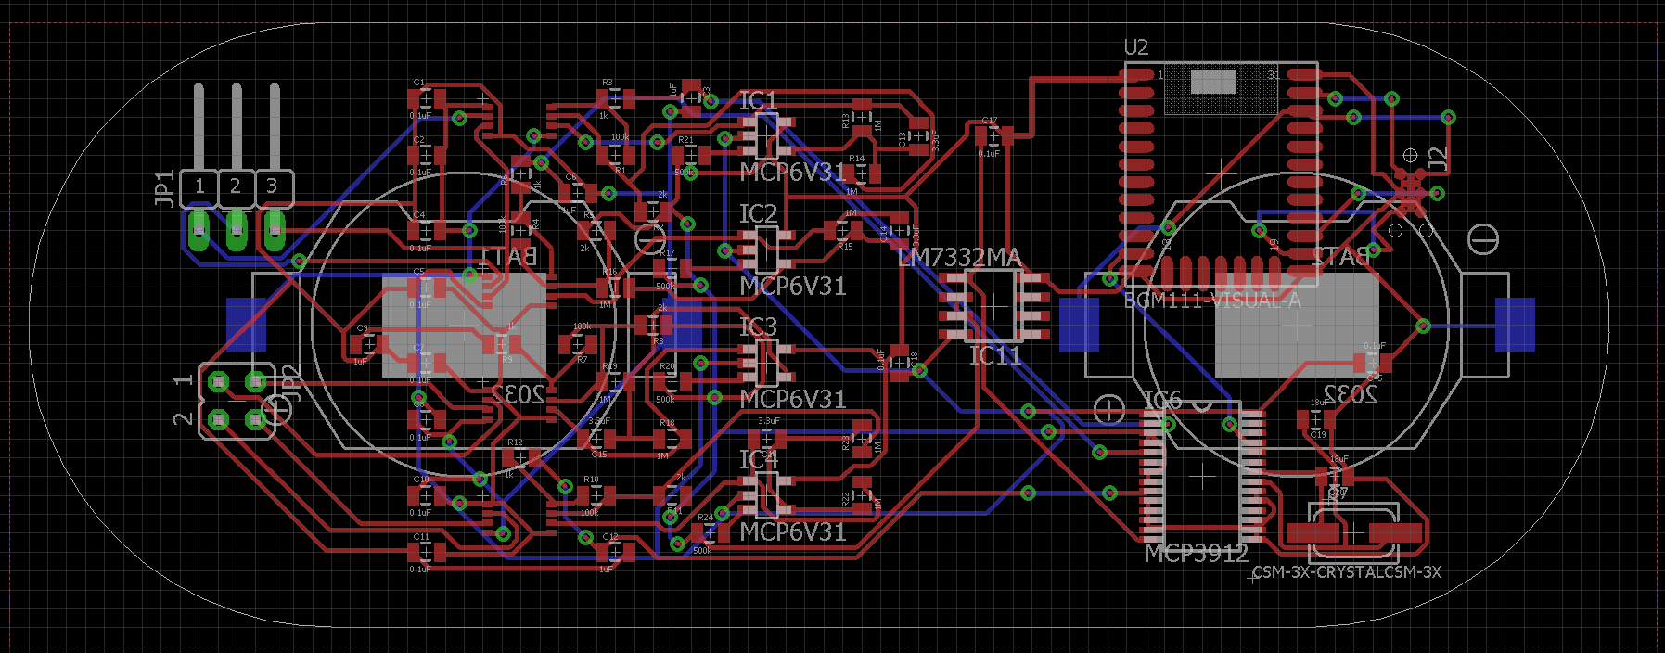
EEG/EMG BOARD

Slide 8
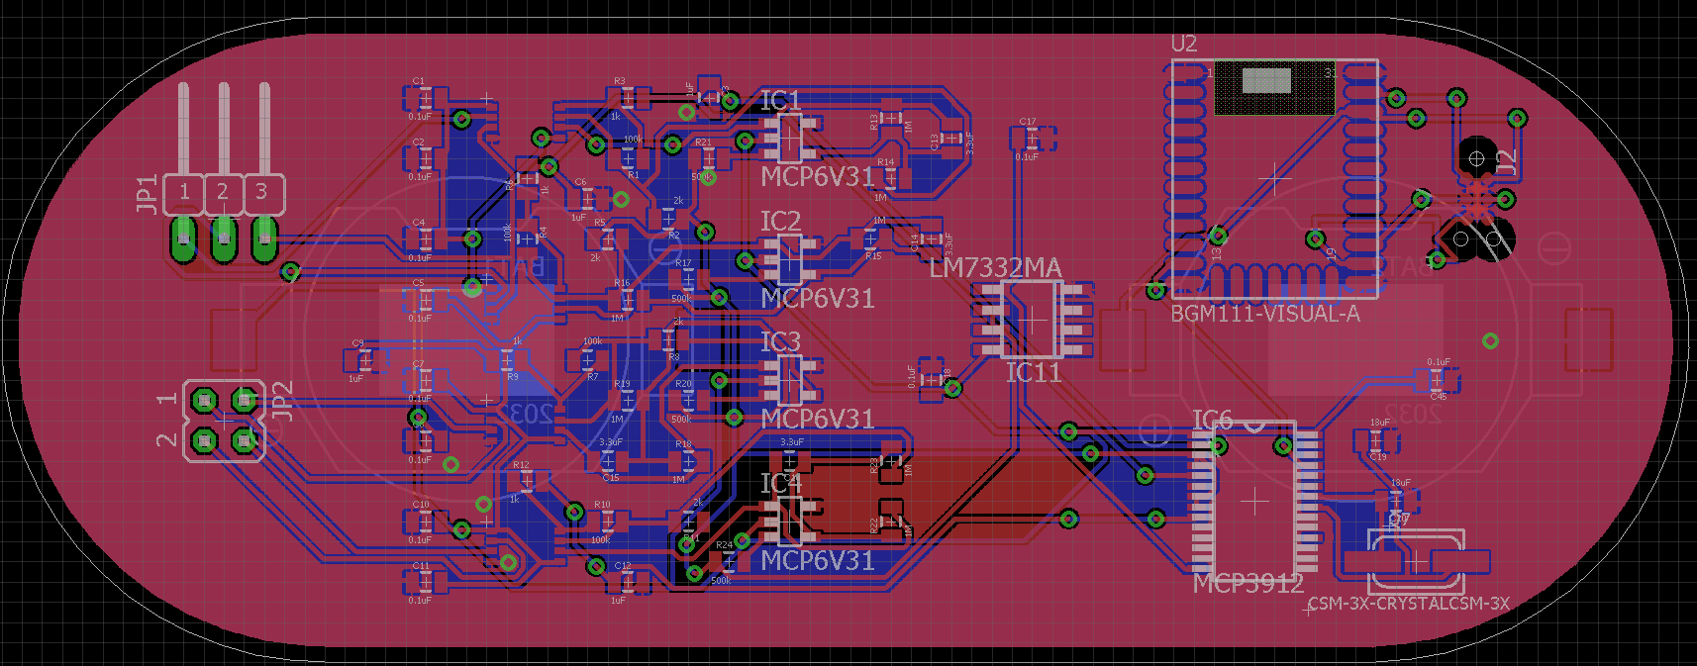
EEG/EMG BOARD WITH GROUND PLANES

Slide 9
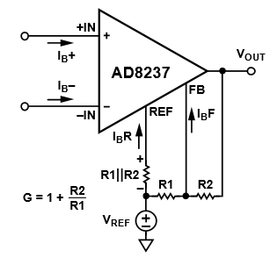
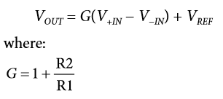
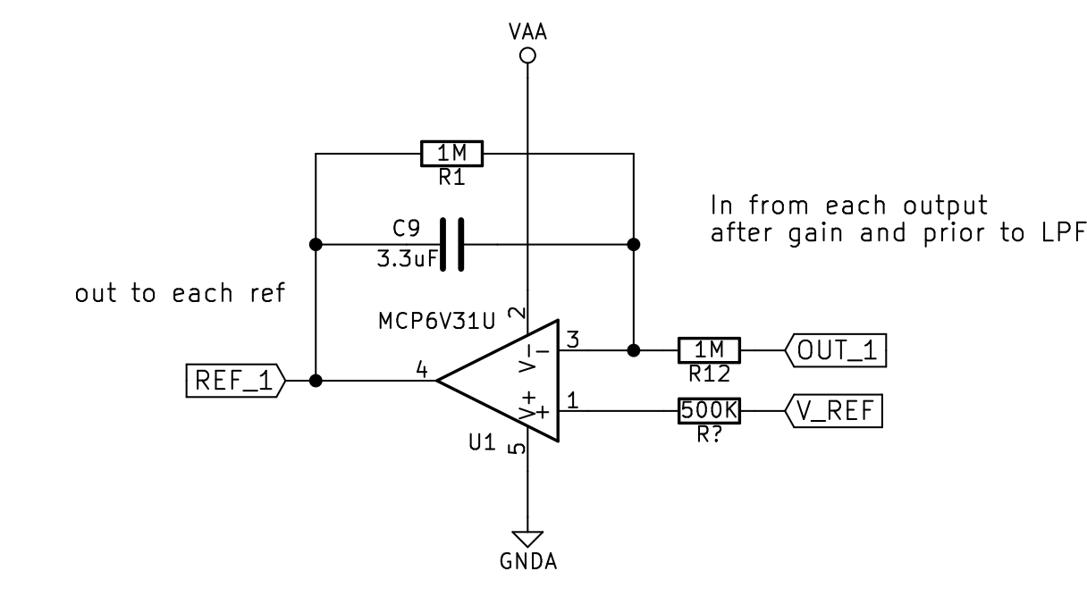
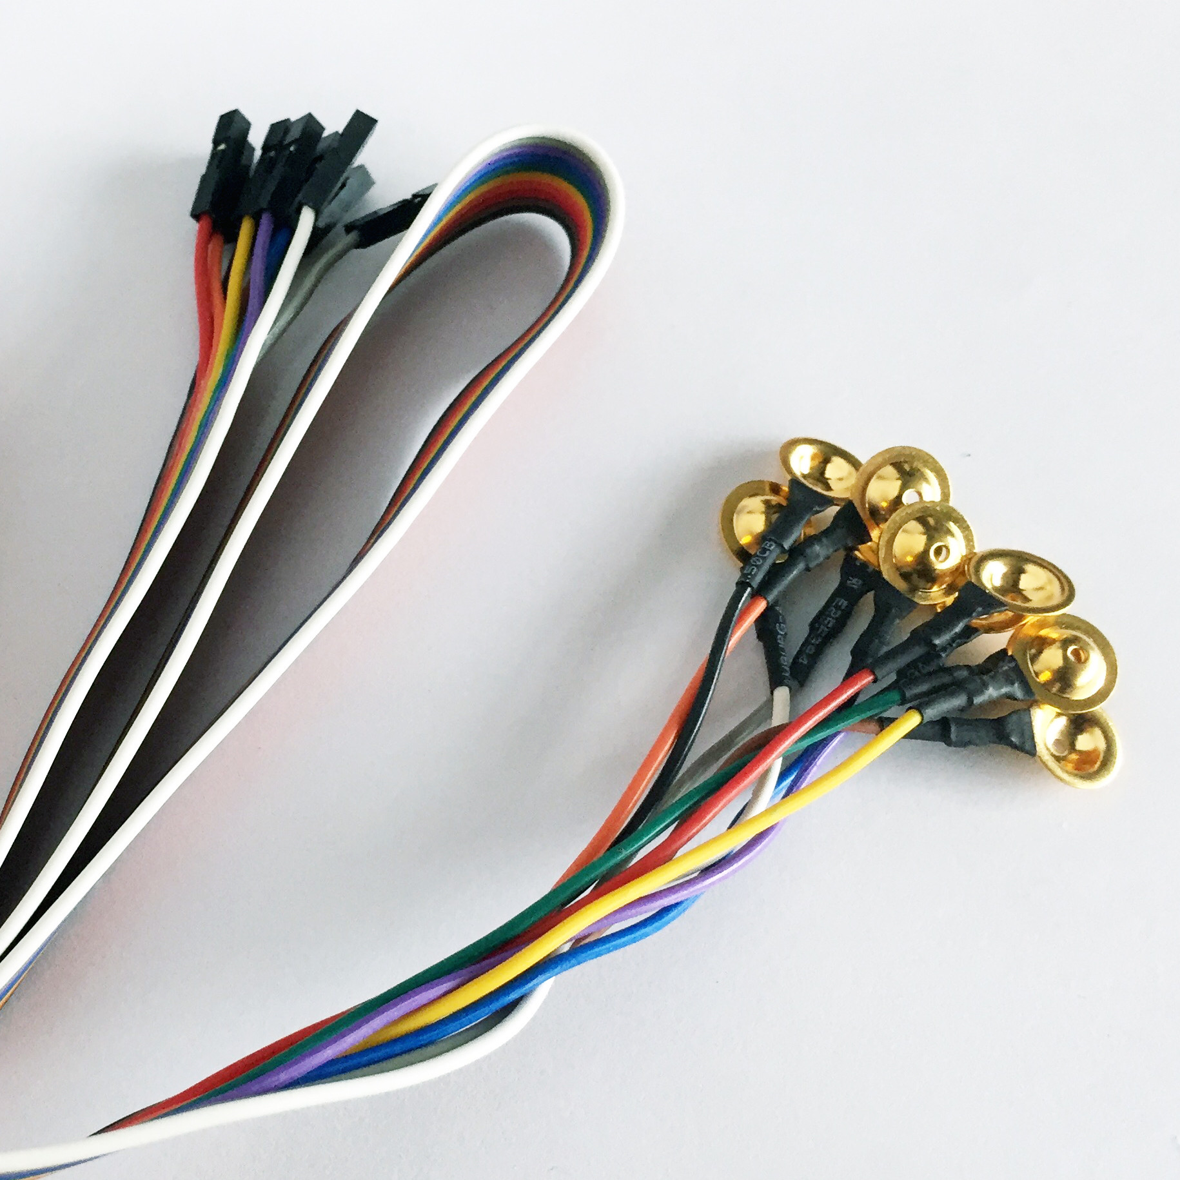
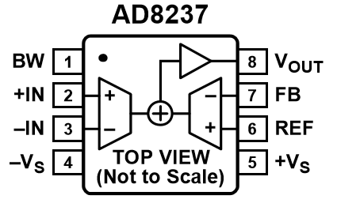
EEG/EMG BOARD
Setting the GAIN

Slide 10
EEG/EMG BOARD
BGM111 Module
3V Four-Channel Analog Front End

Slide 11
Thank You !

